Slide 1

Image Super Resolution using Deep Learning
Saurabh Verma (IT-23/16)
Information Technology
NIT Srinagar
saurabhvipin055@gmail.com
Shish Pal (IT-243/16)
Information Technology
NIT Srinagar
shishpal.barc@gmail.com

Slide 2
Applications
Converting SDTV content to HDTV
Improving quality of Medical images
Daily Surveillance Camera
Earth Remote Sensing
Astronomical Observation
Improve in Biometric Authentication System
Signature Approval (cheque)

Slide 3
Approaches for Image super resolution
Machine Learning Traditional Models.
Interpolation based method.
Manifold based approaches.
Noise resilient image super resolution.
Single channel image super resolution.
Our Approach: end to end mapping of LR and HR images using CNN

Slide 4
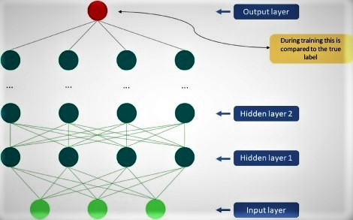
Convolution Neural Network
Source: sciencedirect
Figure: Simple CNN

Slide 5
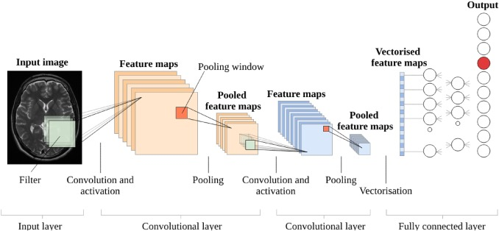
CNN Architecture
Source: sciencedirect

Slide 6
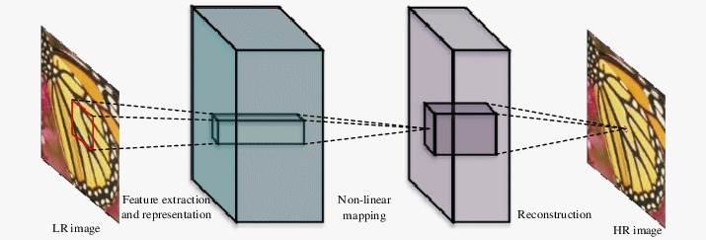
Approach
Deep Neural Network which Integrates Feature extraction, Non-linear mapping and reconstruction.
Figure: SR Architecture

Slide 7
Implementation
Preprocessing upscales LR image to designed HR size.
Feature Extractor(CNN) extracts a set of feature maps from the up-scaled LR image.
Non Linear Mapping maps the feature maps representing LR to HR patches.
Reconstruction produces the HR image from HR patches.

Slide 8
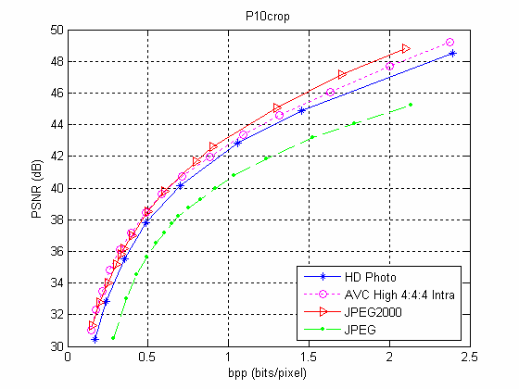
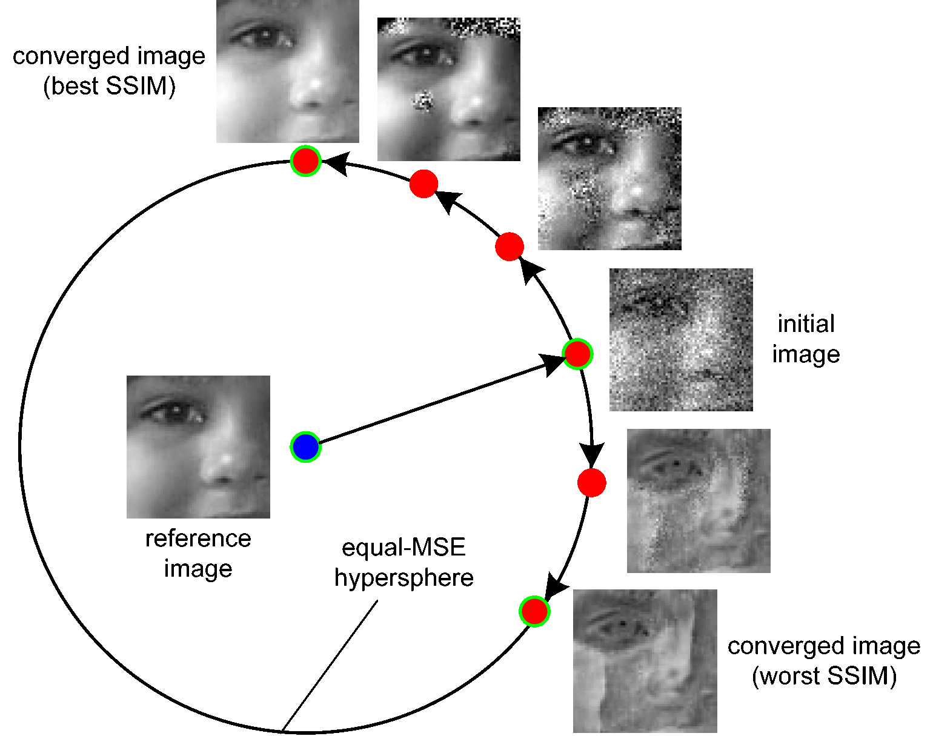
Evaluation: Performance metrics
PSNR (Peek signal to noise ratio)
SSIM (structural Similarity)
Source: Research Gate
Source: https://www.cns.nyu.edu/

Slide 9
Conclusion
Image super resolution is the process of converting low resolution image to high resolution image.
Deep Learning Based model can be utilized for Image Super Resolution.
Our model integrates Preprocessing, Feature extraction, Non linear mapping and Reconstruction.

Slide 10
REFERENCES
Chao Dong, Chen Change Loy, Kaiming He and Xiaoou Tang, "Learning a deep convolutional network for image super-resolution", Computer Vision-ECCV 2014, 2014.
Ezequiel López-Rubio, "Superresolution from a single noisy image by the median filter transform", SIAM Journal on Imaging Sciences, vol. 9, no. 1, 2016.
B. Jolad and R. Khanai, "An Art of Speech Recognition: A Review," 2019 2nd International Conference on Signal Processing and Communication (ICSPC), Coimbatore, India (2019)
D. Meena and R. Sharan, "An approach to face detection and recognition," 2016 International Conference on Recent Advances and Innovations in Engineering (ICRAIE), Jaipur, 2016
Y. Hu, L. Chen and J. Cheng, "A CAPTCHA recognition technology based on deep learning," 2018 13th IEEE Conference on Industrial Electronics and Applications (ICIEA), Wuhan, 2018
Hong Chang, Dit-Yan Yeung, and Yimin Xiong, "Super-resolution through neighbor embedding", Computer Vision and Pattern Recognition 2004. CVPR 2004. Proceedings of the 2004 IEEE Computer Society Conference on, vol. 1, 2004.
Yang Jianchao, Wright John, Thomas S Huang, and Yi Ma, "Image super-resolution via sparse representation", Image Processing IEEE Transactions on, vol. 19, no. 11, 2010.

Slide 11
Thank You!
Questions?

